Slide 1
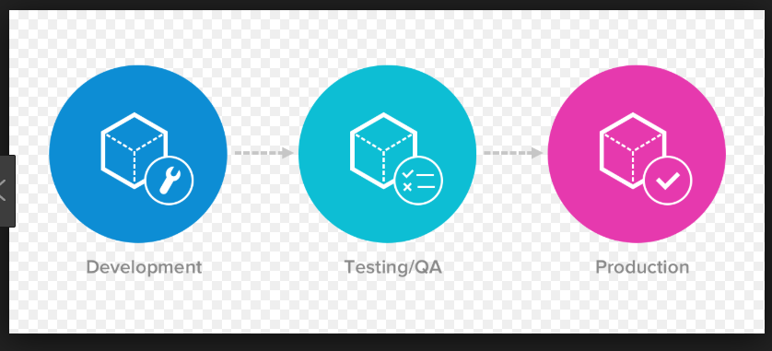
Environment strategies and release management
Release Management:
Planning, Scheduling and Controlling the build lifecycle.
Testing and deploying releases.
Objective:
Improve the release process and increase the number of successful builds.
Environment Strategies:
Benefits:
Increase productivity.
Long-term vs quick/bugs fix.
Eliminates downtime.
Security.
Types:
DEV
Test (SIT, SVP)
Pre-prod (UAT/Staging)
Prod

Slide 2
Versioning System (GIT):
Version control is a system that records changes to a file or a set of files over a time so that you can call specific versions later.
Advantages:
Reverting to previous state.
Comparison.
Track of history and audit history.
Types:
Local
Centralized.
Distributed (GIT)
Advantages:
Widely used
Offline working. Not network access for majority of operations.
Code review pull requests.
Local copy. No single point of failure.

Slide 3
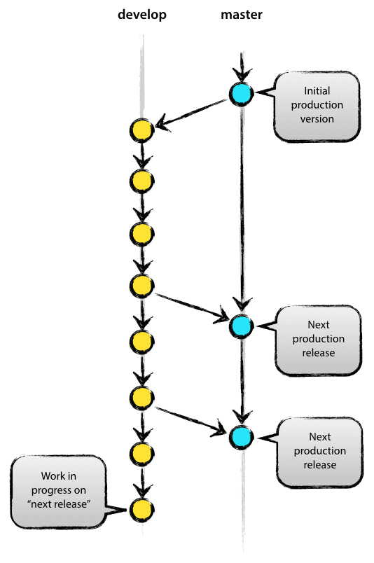
Advantages continue:
Branching/Merging are easy operations.
So faster release cycles (agile).
Branch:
A branch represents an independent line of development.
Branching Strategy:
Types of branches:
Master
Develop
Feature
Release
Hotfix
Steps to the flow with git web UI and commands.

Slide 4
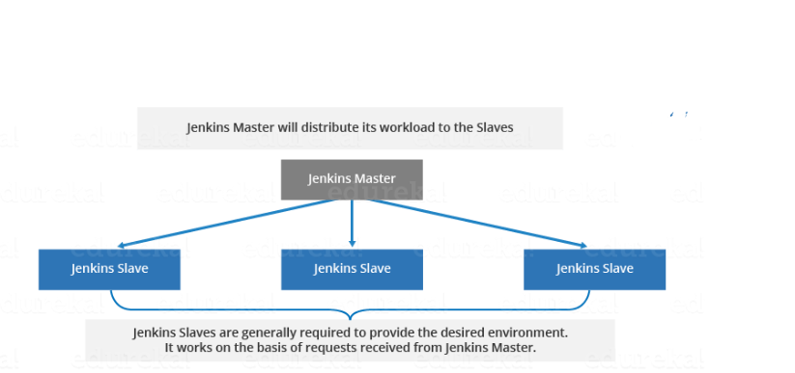
Jenkins:
Jenkins is a web based opensource orchestration tool that allows you to establish CI-CD.
Architecture:
Master:
Scheduling
Dispatching
Monitoring
Recording
Slaves:
Running the job.
Reporting stats back to master.

Slide 5
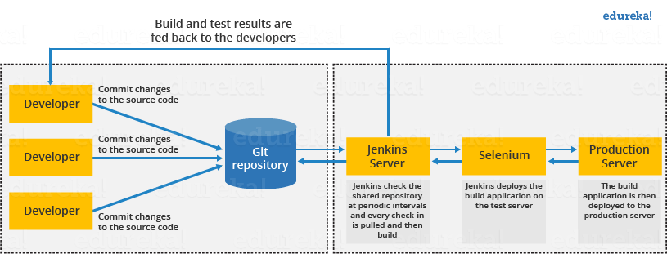
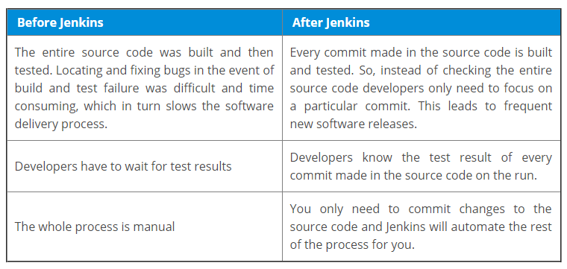

Slide 6
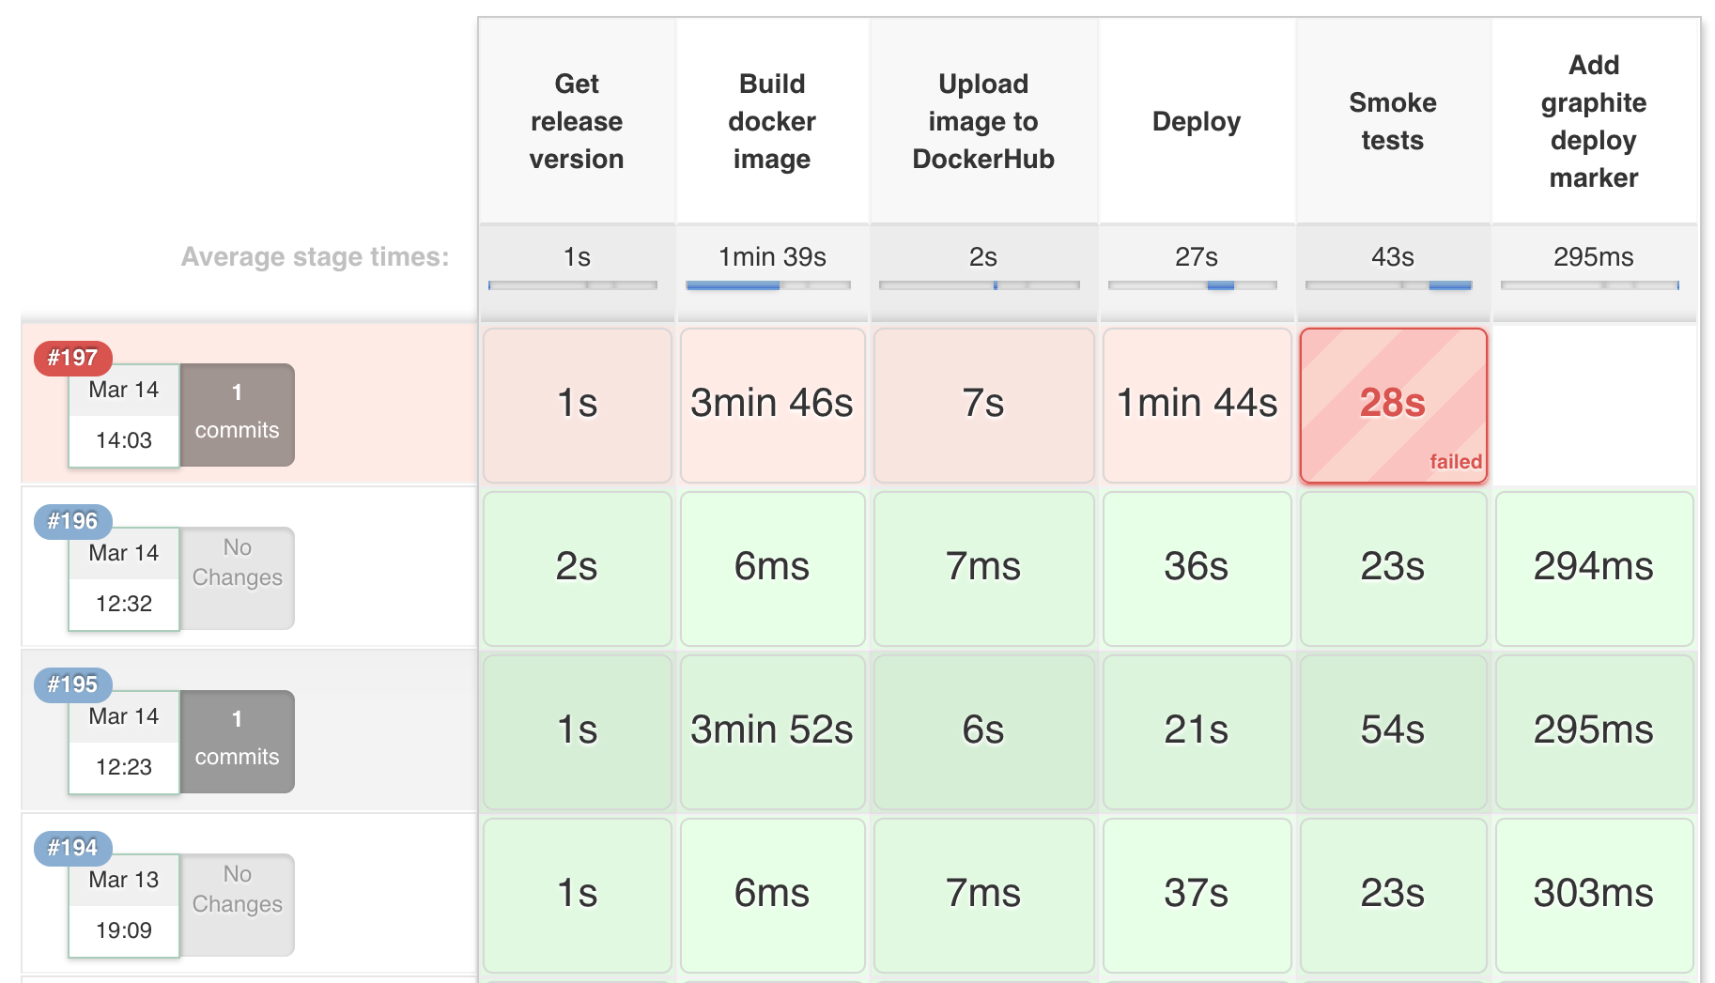
Jenkins delivery pipeline
Reflects the current stages of the various builds.
Different stages can be- testing, packaging, build, deploying and reporting

Slide 7
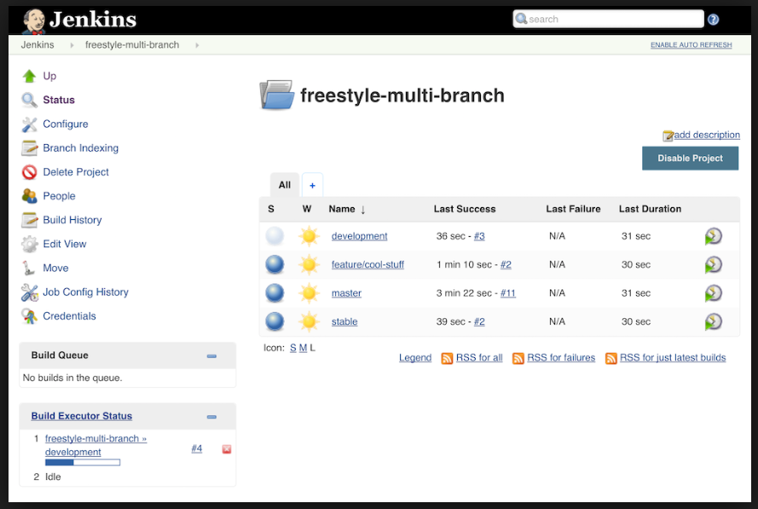
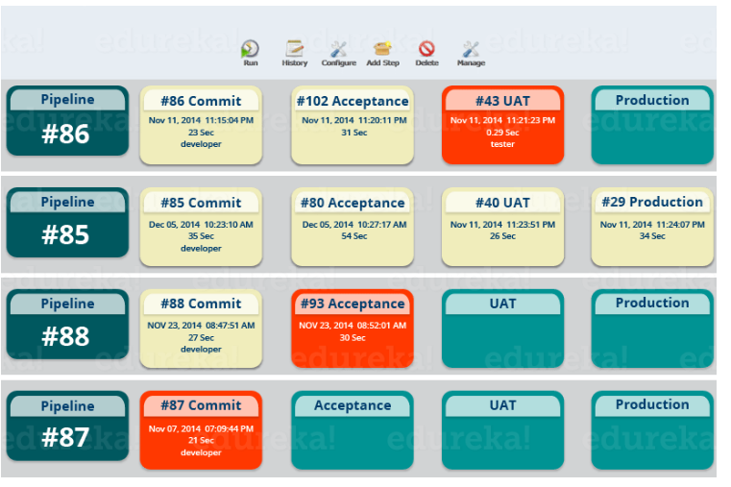

Slide 8
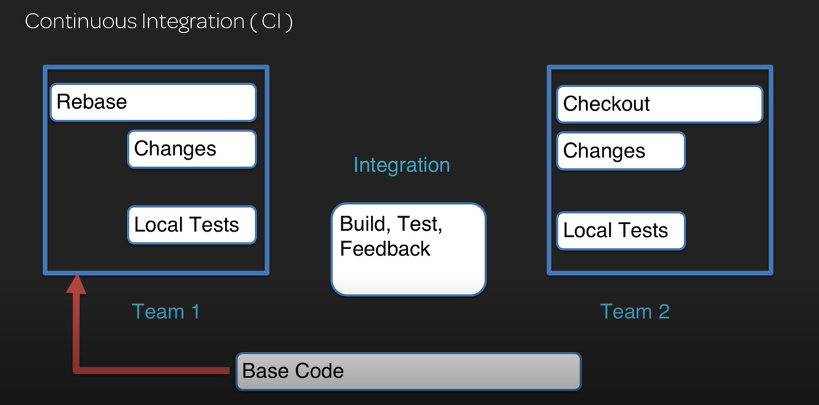
Continuous Integration and Continuous delivery/deployment (CICD):
CI: This is a software development practice in which members of a team integrate their work frequently, at least daily, leading to multiple integration per day.
Helps with bug spotting at the early phases of the software development and feedback to the developers.

Slide 9
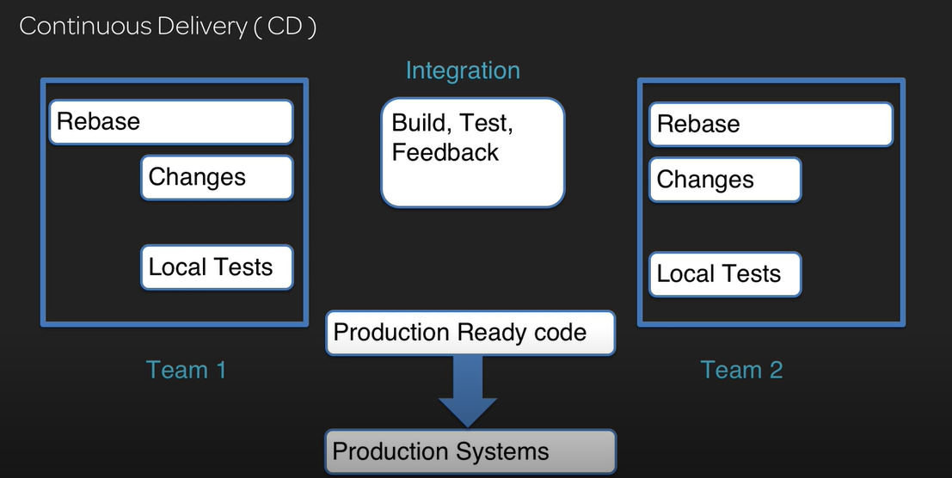
Continuous Delivery (CD)
This is a software development discipline where software is built in a manner that allows for deploying to customers at any time.

Slide 10
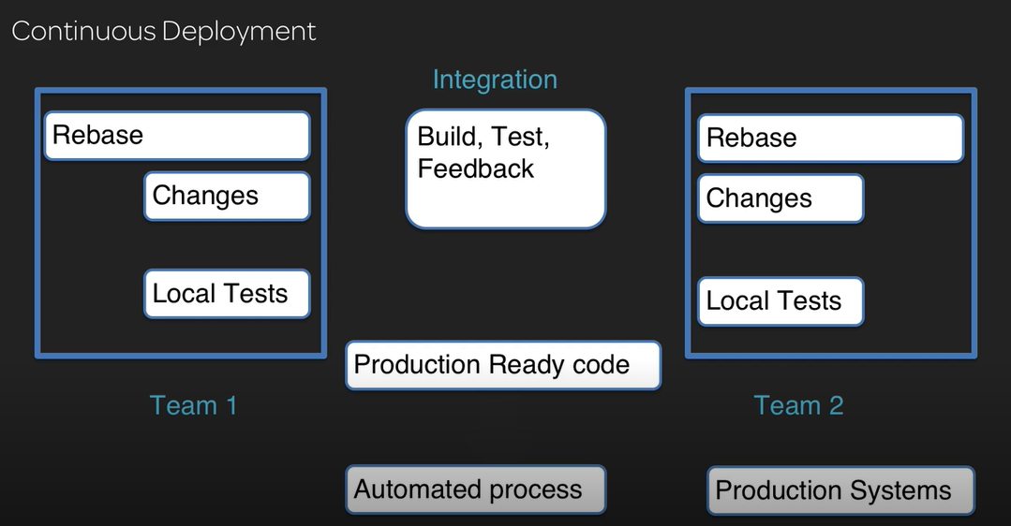
Continuous deployment
This extends the continuous delivery by automating the deployed process so that code is automatically deployed to production after it passes automated testing.

Slide 11
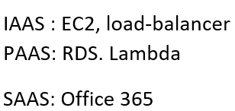
Amazon web services
Cloud computing is the delivery of computing services – including servers, storage, databases, networking, software, analytics and intelligence – over the Internet (“the cloud”) to offer faster innovation, flexible resources and economies of scale.
Benefits:
Cost
Provisioning speed
Productivity.
Performance
Security.
Types:
Public
Private
Hybrid

Slide 12
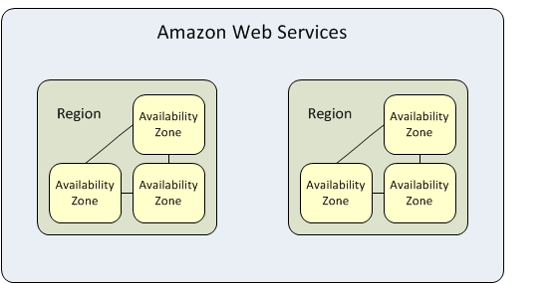
Some Important Services
VPC: A virtual private cloud (VPC) is a virtual network dedicated to your AWS account. It is logically isolated from other virtual networks in the AWS Cloud.
Subnet: A subnet is a range of IP addresses in your VPC.
Region and Availability Zone.
EC2: Virtual servers in cloud.
Types: memory, CPU, cores, OS
Concepts: AMI, SG, NACL, EBS, Volumes

Slide 13
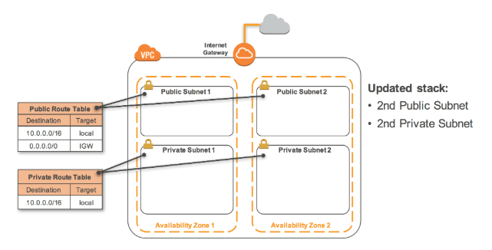

Slide 14
Lambda
AWS Lambda is a compute service that lets you run code without provisioning or managing servers. AWS Lambda executes your code only when needed and scales automatically, from a few requests per day to thousands per second.
Limits:
Concurrent execution -1000
Timeout 15 minutes
Memory allocation :3008 MB
Deployment package size : 250 MB
What is Event.
Lambda Layers.

Slide 15
S3: Simple storage service
Amazon Simple Storage Service (Amazon S3) is an object storage service that offers industry-leading scalability, data availability, security, and performance with 99.999999999% durability.
Storage classes:
S3 standard.
S3 standard IA. (Infrequently stored)
Glacier.
Features:
Encryption.
Infinite amount of data in a bucket.
Life cycle policies for data movement.
Versioning.

Slide 16
Serverless
Serverless computing is a an execution model where the cloud provider is responsible for executing a piece of code dynamically allocating the resources. and only charging for the amount of resources used.
It is Important to follow microservice approach where you divide the complete functionality into multiple functions as we have limitations on the resources.
Problems with traditional approach:
Idle time.
Maintenance.
Patching.
Scaling capabilities.
Slows development process.
Lambda can be taken as a primary component for serverless computing.
Trigger events:
Https requests, database events, file uploads, scheduled events using cloud watch.
Stateless functions. You are assigned a new container every time.(/tmp)

Slide 17
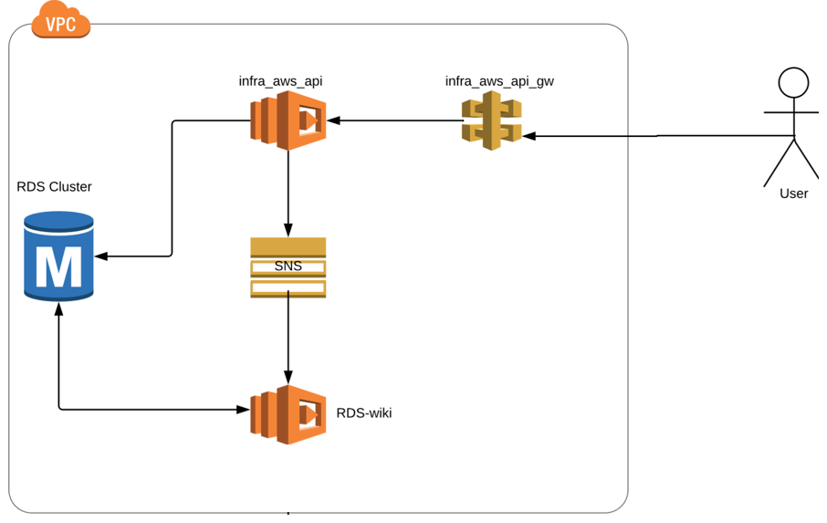
Serverless sample architecture

Slide 18
Q&A

